Slide 1

Enhanced Spam Classification with Improved Accuracy Using Refined Stacking with Voting Meta - Classifier
R.V. R. & J. C. College of Engineering
Autonomous(A)
Under the Guidance of
Dr. P. Srinivasa Rao
Associate Professor
Dept. of CSD
Batch No : Y22CD/04
Kanchi Nissy Y22CD064
Eppakayala Sathvik Y22CD033

Slide 2
Contents
Abstract
Problem Statement
Literature Survey
Existing System
Proposed System
Data Preprocessing Flowchart
Proposed System Flowchart
Results for Stacking Classifier
Results for Voting Classifier
Datasets
Methodology
Results Comparison
Conclusion & Future Scope
References

Slide 3
Abstract
Spam email detection is a critical task in cybersecurity, protecting users from phishing, malware, and fraudulent activities. Traditional machine learning models, while effective, often struggle with high false positive rates and evolving spam techniques. This study implements Stacking and Voting Classifiers to enhance accuracy and robustness. The system combines Logistic Regression, Decision Tree, and Multinomial Naive Bayes,—to achieve optimal classification precision. Experimental results show a highest-ever accuracy of 98.53% and a highest-ever recall measure of 99.09%, outperforming other spam detection algorithms. Results highlight the strengths of ensemble methods in improving spam detection performance.

Slide 4
Problem Statement
Spam emails pose a significant cybersecurity threat, leading to phishing attacks, financial fraud, and information breaches. Traditional machine learning models (e.g., Naive Bayes, Decision Trees, KNN) and ensemble techniques like stacking have improved spam detection accuracy. However, stacking classifiers depend on a single meta-classifier, which can introduce computational complexity, risk of overfitting, and reduced interpretability.

Slide 5
Literature Survey
Research Title | Problem Statement | Proposed Methodology | Parameters Evaluated | Advantages | Disadvantages
[1] Sahoo et al. (2024): An Ensemble Method for Spam Classification | Traditional single classifiers struggle with accuracy and recall in spam detection. | Ensemble method combining Logistic Regression, Decision Trees, and Random Forest for improved spam detection. | Accuracy – 97.5% | Improved accuracy compared to individual classifiers. | May require higher computational power for ensemble learning.
[2] Hoque et al. (2024): Enhancing Spam Email Detection with an Optimized Soft Voting Ensemble Classifier | Traditional classifiers fail to optimize decision-making in spam filtering. | Soft voting ensemble classifier with optimized weighting for better classification. | Accuracy – 98.2% | Outperforms traditional classifiers by optimizing weights for better decision-making. | Weight optimization complexity may increase processing time.
[3] Alzahrani (2024): Explainable AI-based Framework for Efficient Detection of Spam | Lack of interpretability in AI-driven spam classification. | Stacking ensemble with explainability features. | Accuracy – 96.8% | High accuracy with explainability for better trust and transparency. | Complexity in model interpretation may lead to slower decision-making.

Slide 6
Literature Survey
Research Title | Problem Statement | Proposed Methodology | Parameters Evaluated | Advantages | Disadvantages
[7] Sharma et al. (2024): Hybrid Classifier for Enhancing Spam Detection | Email spam classification requires better precision and reduced false positives. | Hybrid classifier combining Naïve Bayes, SVM, and ensemble methods. | Precision – 97.2% | Reduced false positives in email spam detection. | Computational cost increases due to multiple classifiers.
[8] Tyagi et al. (2024): Enhancing SMS Classification with Ensemble Learning | Rule-based spam filters are less effective than ML-based classifiers. | Ensemble voting system for spam detection. | Accuracy – 97.8% | Machine learning-based classifiers outperform rule-based filters. | Requires feature engineering for effective spam classification.

Slide 7
Existing System
The existing system focuses on spam email classification using a stacking ensemble approach to improve accuracy. The system integrates five machine learning classifiers: Logistic Regression, Decision Tree, K-Nearest Neighbors (KNN), Gaussian Naive Bayes (NB), AdaBoost.
Data Preprocessing
Combines two datasets (SpamAssassin & Enron) consisting of approximately 7,000 emails in total.
Balances spam and ham emails to prevent bias.
Uses TF-IDF for feature extraction.
Stacking Classifier
Base classifiers generate predictions.
A meta-classifier (Logistic Regression) learns from these predictions for final classification.

Slide 8
Proposed System
The proposed approach for spam classification utilizes Natural Language Processing (NLP) and machine learning techniques to effectively distinguish spam emails from legitimate ones. The dataset undergoes preprocessing, including text cleaning, URL removal, Special character removal, stop-word removal, and numerical conversion using TF-IDF vectorization. The data is then balanced and split into training and testing sets to prevent bias. Multiple base classifiers, including Logistic Regression, Decision Trees, and Multinomial Naive Bayes are trained to identify spam patterns. To enhance accuracy, ensemble learning methods such as Voting Classifier (hard voting) and Stacking Classifier are implemented. The model's performance is evaluated using accuracy, precision, recall, F1-score, and confusion matrix. The best-performing model is saved for real-time deployment.

Slide 9
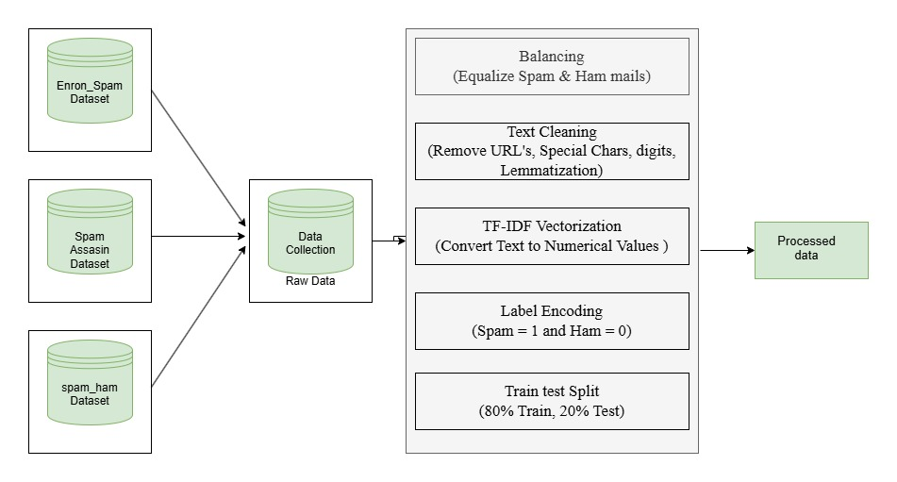
Data Preprocessing Architecture

Slide 10
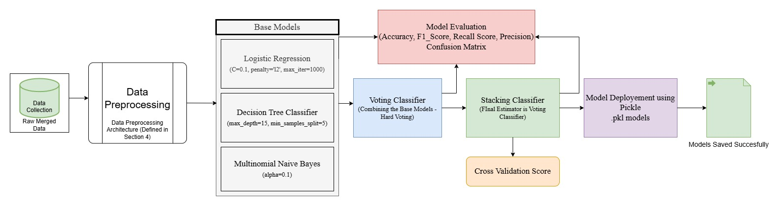
Proposed System Architecture

Slide 11
Results for Stacking Classifier
Parameters | Value
Accuracy | 98.53%
Precision | 0.9750
Recall | 0.9922
F1 Score | 0.9835

Slide 12
Results for Voting Classifier
Parameters | Value
Accuracy | 97.82%
Precision | 0.9635
Recall | 0.9938
F1 Score | 0.9784

Slide 13



Datasets
Spam-apache
Enron_spam_data
Spam_ham_dataset

Slide 14
Methodology
1. Data Preprocessing
The dataset is loaded, and missing values are handled.
Text cleaning includes removing special characters, punctuation, and stop words.
Text is converted into numerical format using:
TF-IDF Vectorization
The target labels are encoded: Spam = 1, Ham = 0.
2. Data Splitting and Balancing
The dataset is split into training (80%) and testing (20%) subsets.
To prevent bias, data balancing techniques are applied:
Undersampling or Oversampling to ensure equal spam and ham distribution.
3. Model Training with Base Classifiers
To ensure high performance, multiple machine learning classifiers are trained:
Logistic Regression – for simple linear decision-making.
Decision Tree Classifier – captures complex decision patterns.
Multinomial Naïve Bayes – effective for text-based classification.

Slide 15
Methodology
4. Ensemble Learning for Improved Accuracy
To enhance classification accuracy, ensemble techniques are applied:
Voting Classifier
Combines base classifiers using hard voting.
Stacking Classifier
It uses base models as estimators and the Voting Classifier as the final estimator.
5. Model Evaluation
The trained models are evaluated using multiple metrics:
Accuracy – Measures overall correctness.
Precision – Determines how many predicted spam emails are actually spam.
Recall – Identifies how many actual spam emails were detected.
F1-Score – Balances precision and recall.
Confusion Matrix – Provides insight into misclassifications.
6. Model Deployment and Future Enhancements
The best-performing model is saved using pickle for real-time classification.

Slide 16
Results Comparison
Model | Accuracy | Precision | Recall | F1-score
Stacking Classifier | 98.53% | 0.9750 | 0.9922 | 0.9835
Voting Classifier | 97.82% | 0.9635 | 0.9938 | 0.9784
Logistic Regression | 97.35% | 0.9545 | 0.9940 | 0.9739
Decision Tree Classifier | 92.62% | 0.8949 | 0.9648 | 0.9285
Multinomial Naïve Bayes | 97.80% | 0.9773 | 0.9784 | 0.9778

Slide 17
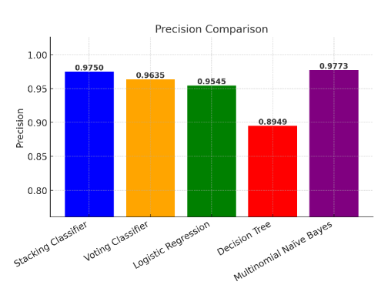
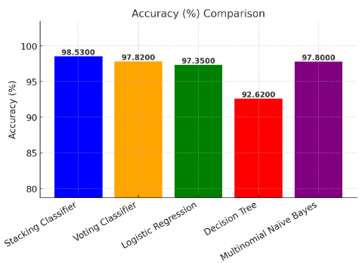

Slide 18
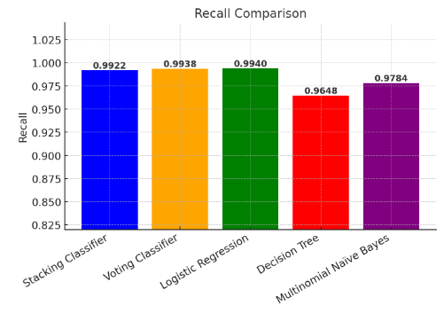
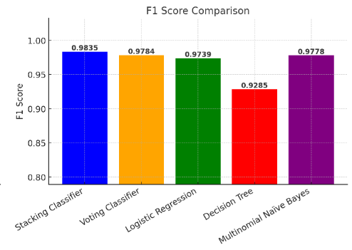

Slide 19
Conclusion & Future Scope
This study presents an ensemble-based spam email classification system using Stacking and Voting Classifiers to improve detection accuracy. By combining multiple machine learning models—Logistic Regression, Decision Tree and Multinomial Naive Bayes—the system effectively reduces false positives and false negatives. TF-IDF Vectorization ensures efficient feature extraction, while the meta-model(Voting classifier) in stacking learns optimal weight assignments, improving performance. The trained model is deployable for real-world applications, offering robust and scalable spam detection compared to individual classifiers. This system can be further enhanced by incorporating BERT or GPT for improved text representation.

Slide 20
References
Adnan, M., Imam, M.O., Javed, M.F. et al. Improving spam email classification accuracy using ensemble techniques: a stacking approach. Int. J. Inf. Secur. 23, 505–517 (2024). https://doi.org/10.1007/s10207-023-00756-1
A. Alzahrani, "Explainable AI-based Framework for Efficient Detection of Spam from Text using an Enhanced Ensemble Technique," Engineering, Technology & Applied Science Research, 2024.
A. K. Mehta and S. Kumar, "Comparative Analysis and Optimization of Spam Filtration Techniques Using Natural Language Processing," IEEE Xplore, 2024.
R. Raut, A. B. Chandanshive, P. N. Gadkar, et al., "Credit Card Fraud Detection Using Ensemble Modeling," IEEE Xplore, 2024.
B. Mankar, M.Wanjari, and D. Gabhane, "Spam SMS Classifier Using Machine Learning Algorithms," IEEE Xplore, 2024.
A. Rahman, S. Parvej, K. S. Alam, et al., "Optimizing SMS Spam Detection: Comparative Analysis of Hybrid Voting Ensembles and Bi LSTM Networks with Stratified Cross-Validation," ResearchGate, 2024.
S. Kamalesh, N. Niveatha, et al., "Enhanced Spam Classification Model Through Text Processing and Fusion DL Models," IEEE Xplore, 2024.

Slide 21
Thank You

